Slide 1
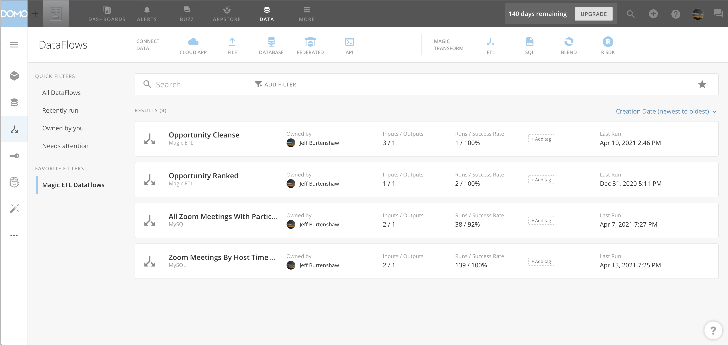
1
2
3

Slide 2
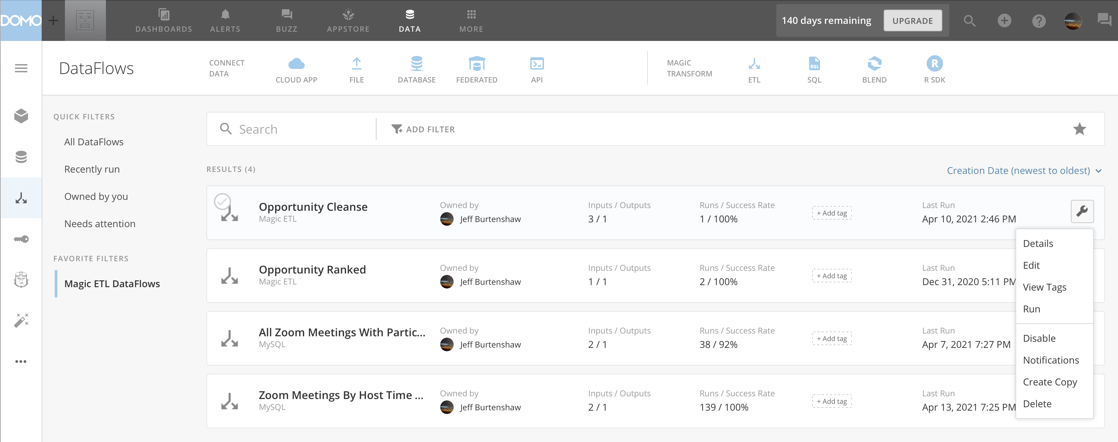
1
2

Slide 3
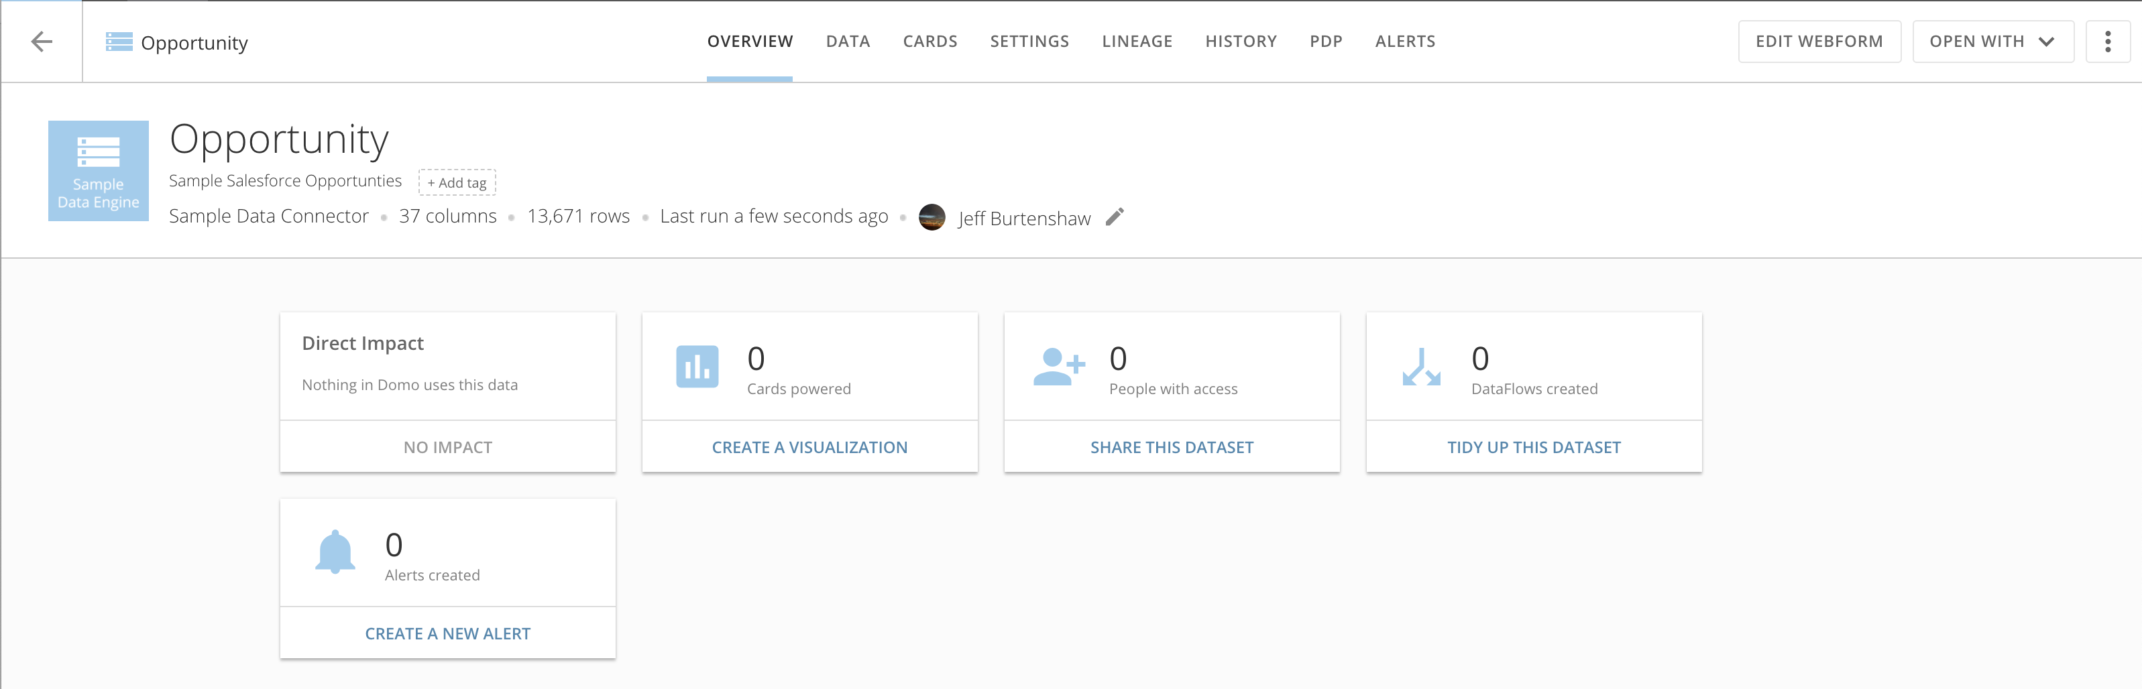
Dataset Name
# Fields
Volume
Refreshed
Tabs
Options
Owner
Change Owner
Connector Type
Tab Panel

Slide 4
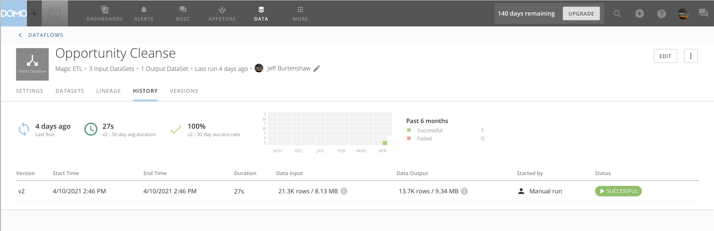
DataFlow Name
# Inputs
Refreshed
Breadcrumb
DataFlow Type
# Outputs
Options
Owner
Change Owner
Tabs
Tab Panel

Slide 5
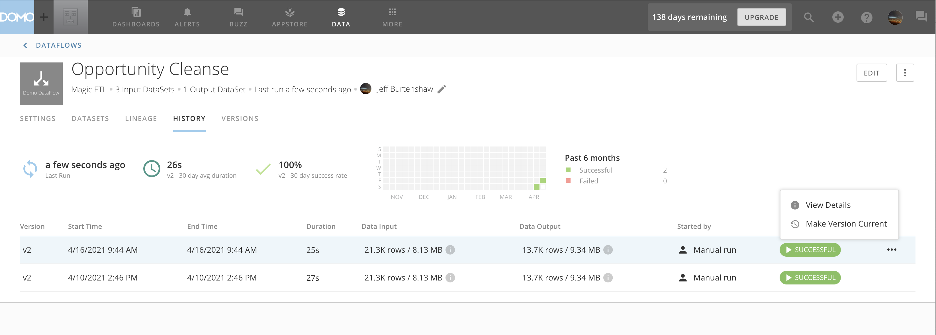
1

Slide 6
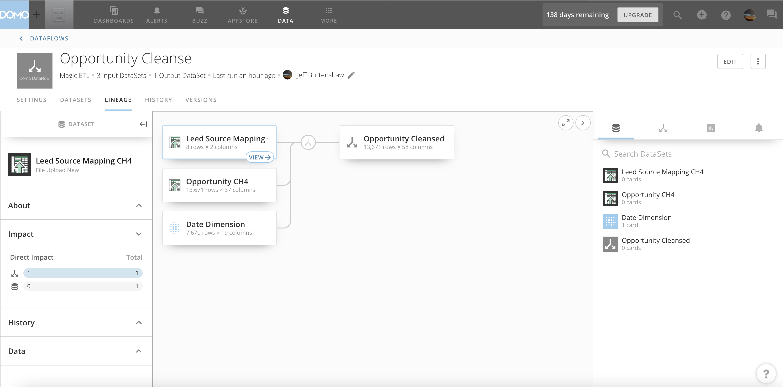
Canvas Highlighted Artifact Details
Artifact Canvas
Faceted Dataflow Artifact Search

Slide 7
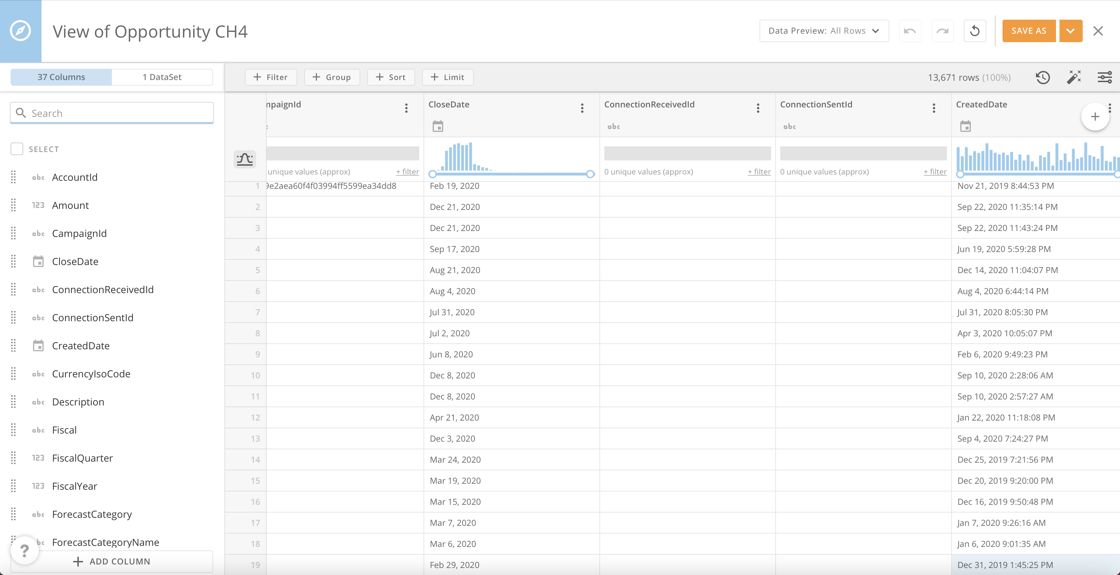
View Name
Preview Rows
Save View
Join Tab
Row Operators
Undo
Redo
Revert
View History
Column Tab
AI Suggested Views
Column Search
Display Properties
Column Options
Column Selection
Column Handle
Column Data Type
Column Data Profile
Data Profile Toggle
Columns
Add Columns

Slide 8
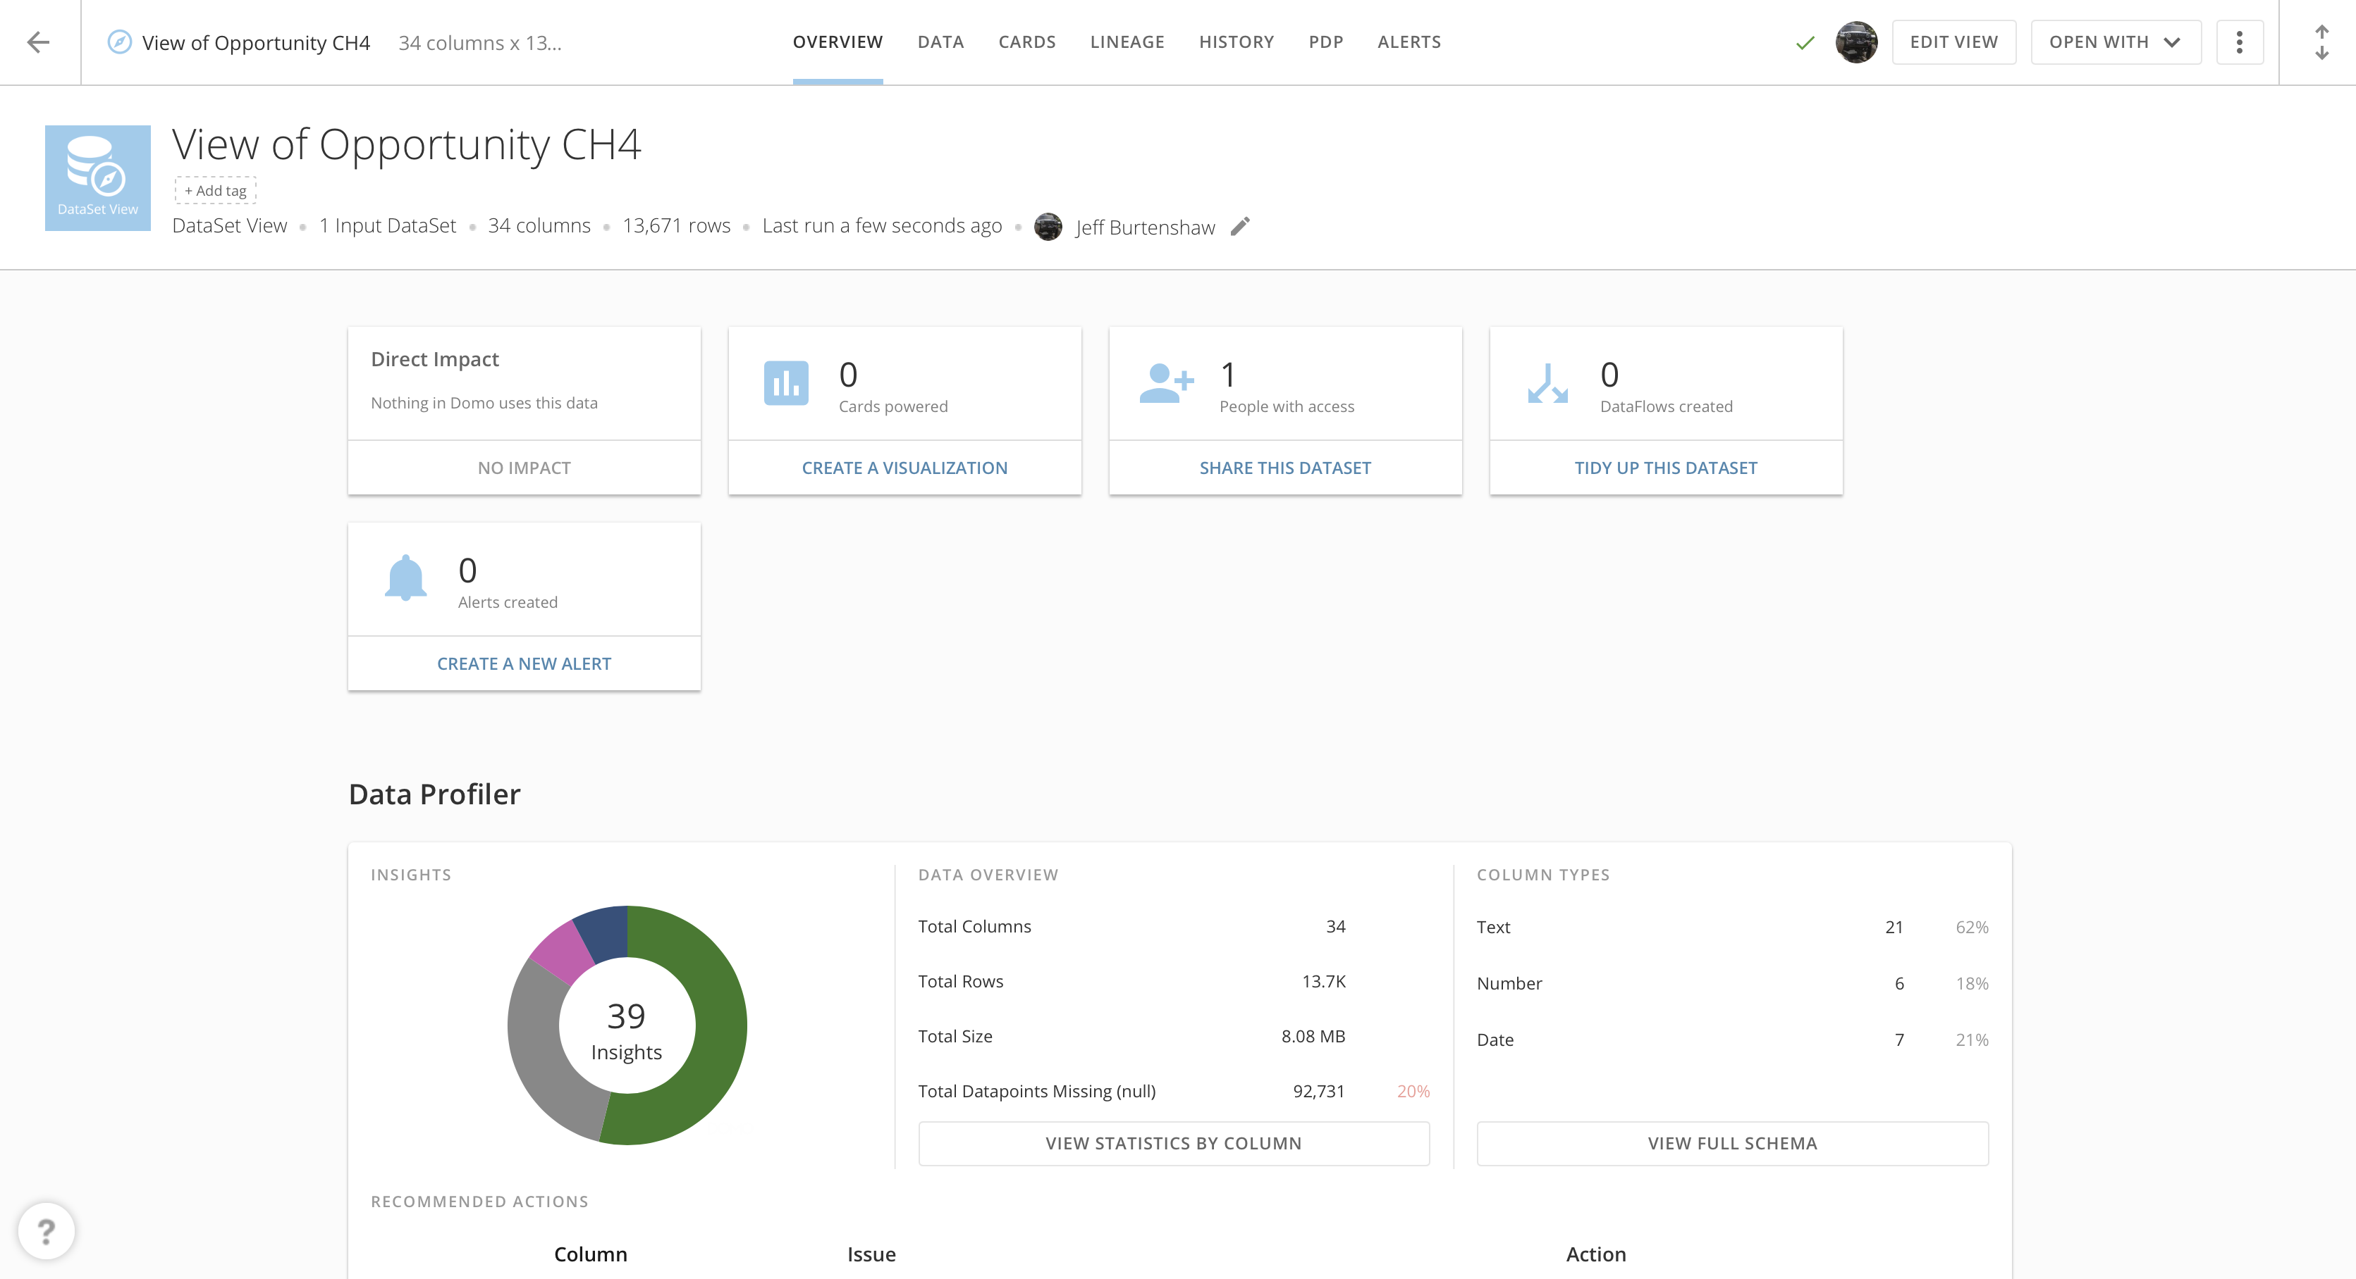
Edit View

Slide 9
